Slide 1
Naturalist
Jake Gadaleta

Slide 2
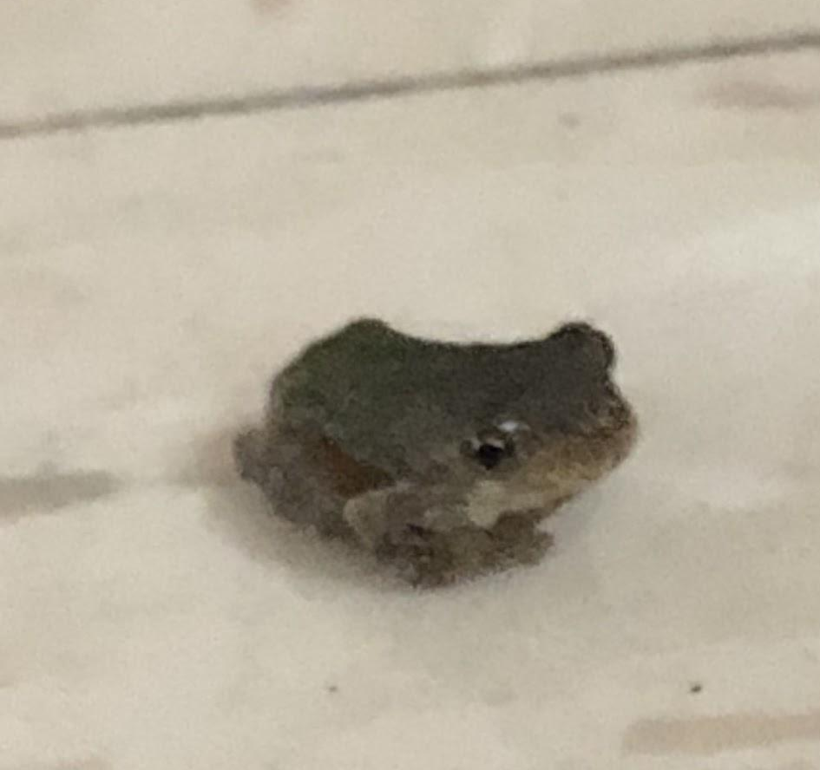
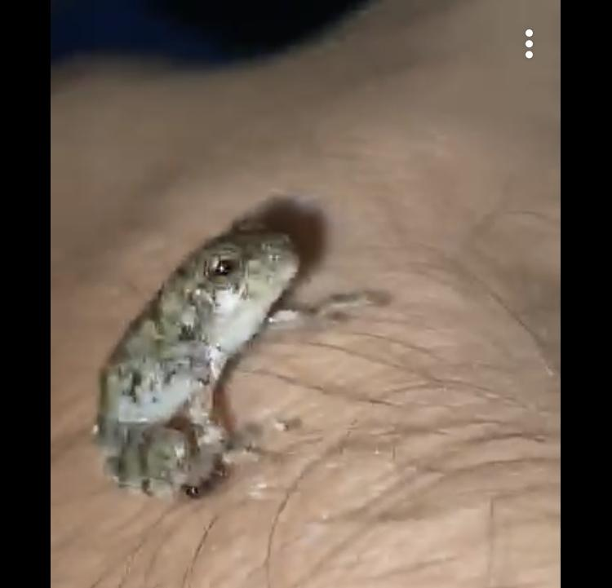
#1
Common Name: Spring peeper
Scientific name: Pseudacris crucifer
Location: Eastern Us & Canada (Villas)
Date: Aug 25 2020
Habitat: forests , woodlands, wetlands, requires marshes, ponds, or swamp regions to support the aquatic environment the eggs and tadpoles need.
Fact: The Smallest Frog in PA

Slide 3
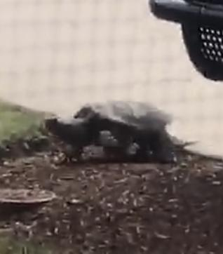
#2
Common Name: Snapping Turtle
Scientific name: Chelydra serpentina
Location: southeastern canada - southwestern Rocky Mountains- Nova Scotia - Florida (Villas)
Date: Aug 28 2020
Habitat: shallow ponds or streams
Fact: heaviest native freshwater turtle

Slide 4
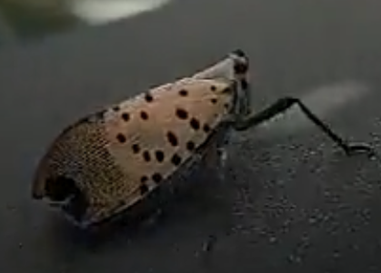
#3
Localized Name: American Dun-bar Moth
Scientific name: Cosmia calami
Location: Primarily East Coast USA, (my car, outside of Donahue)
Date: Sept 10 2020
Habitat: Woodland, gardens
Fact: Wingspan 25-33 mm

Slide 5
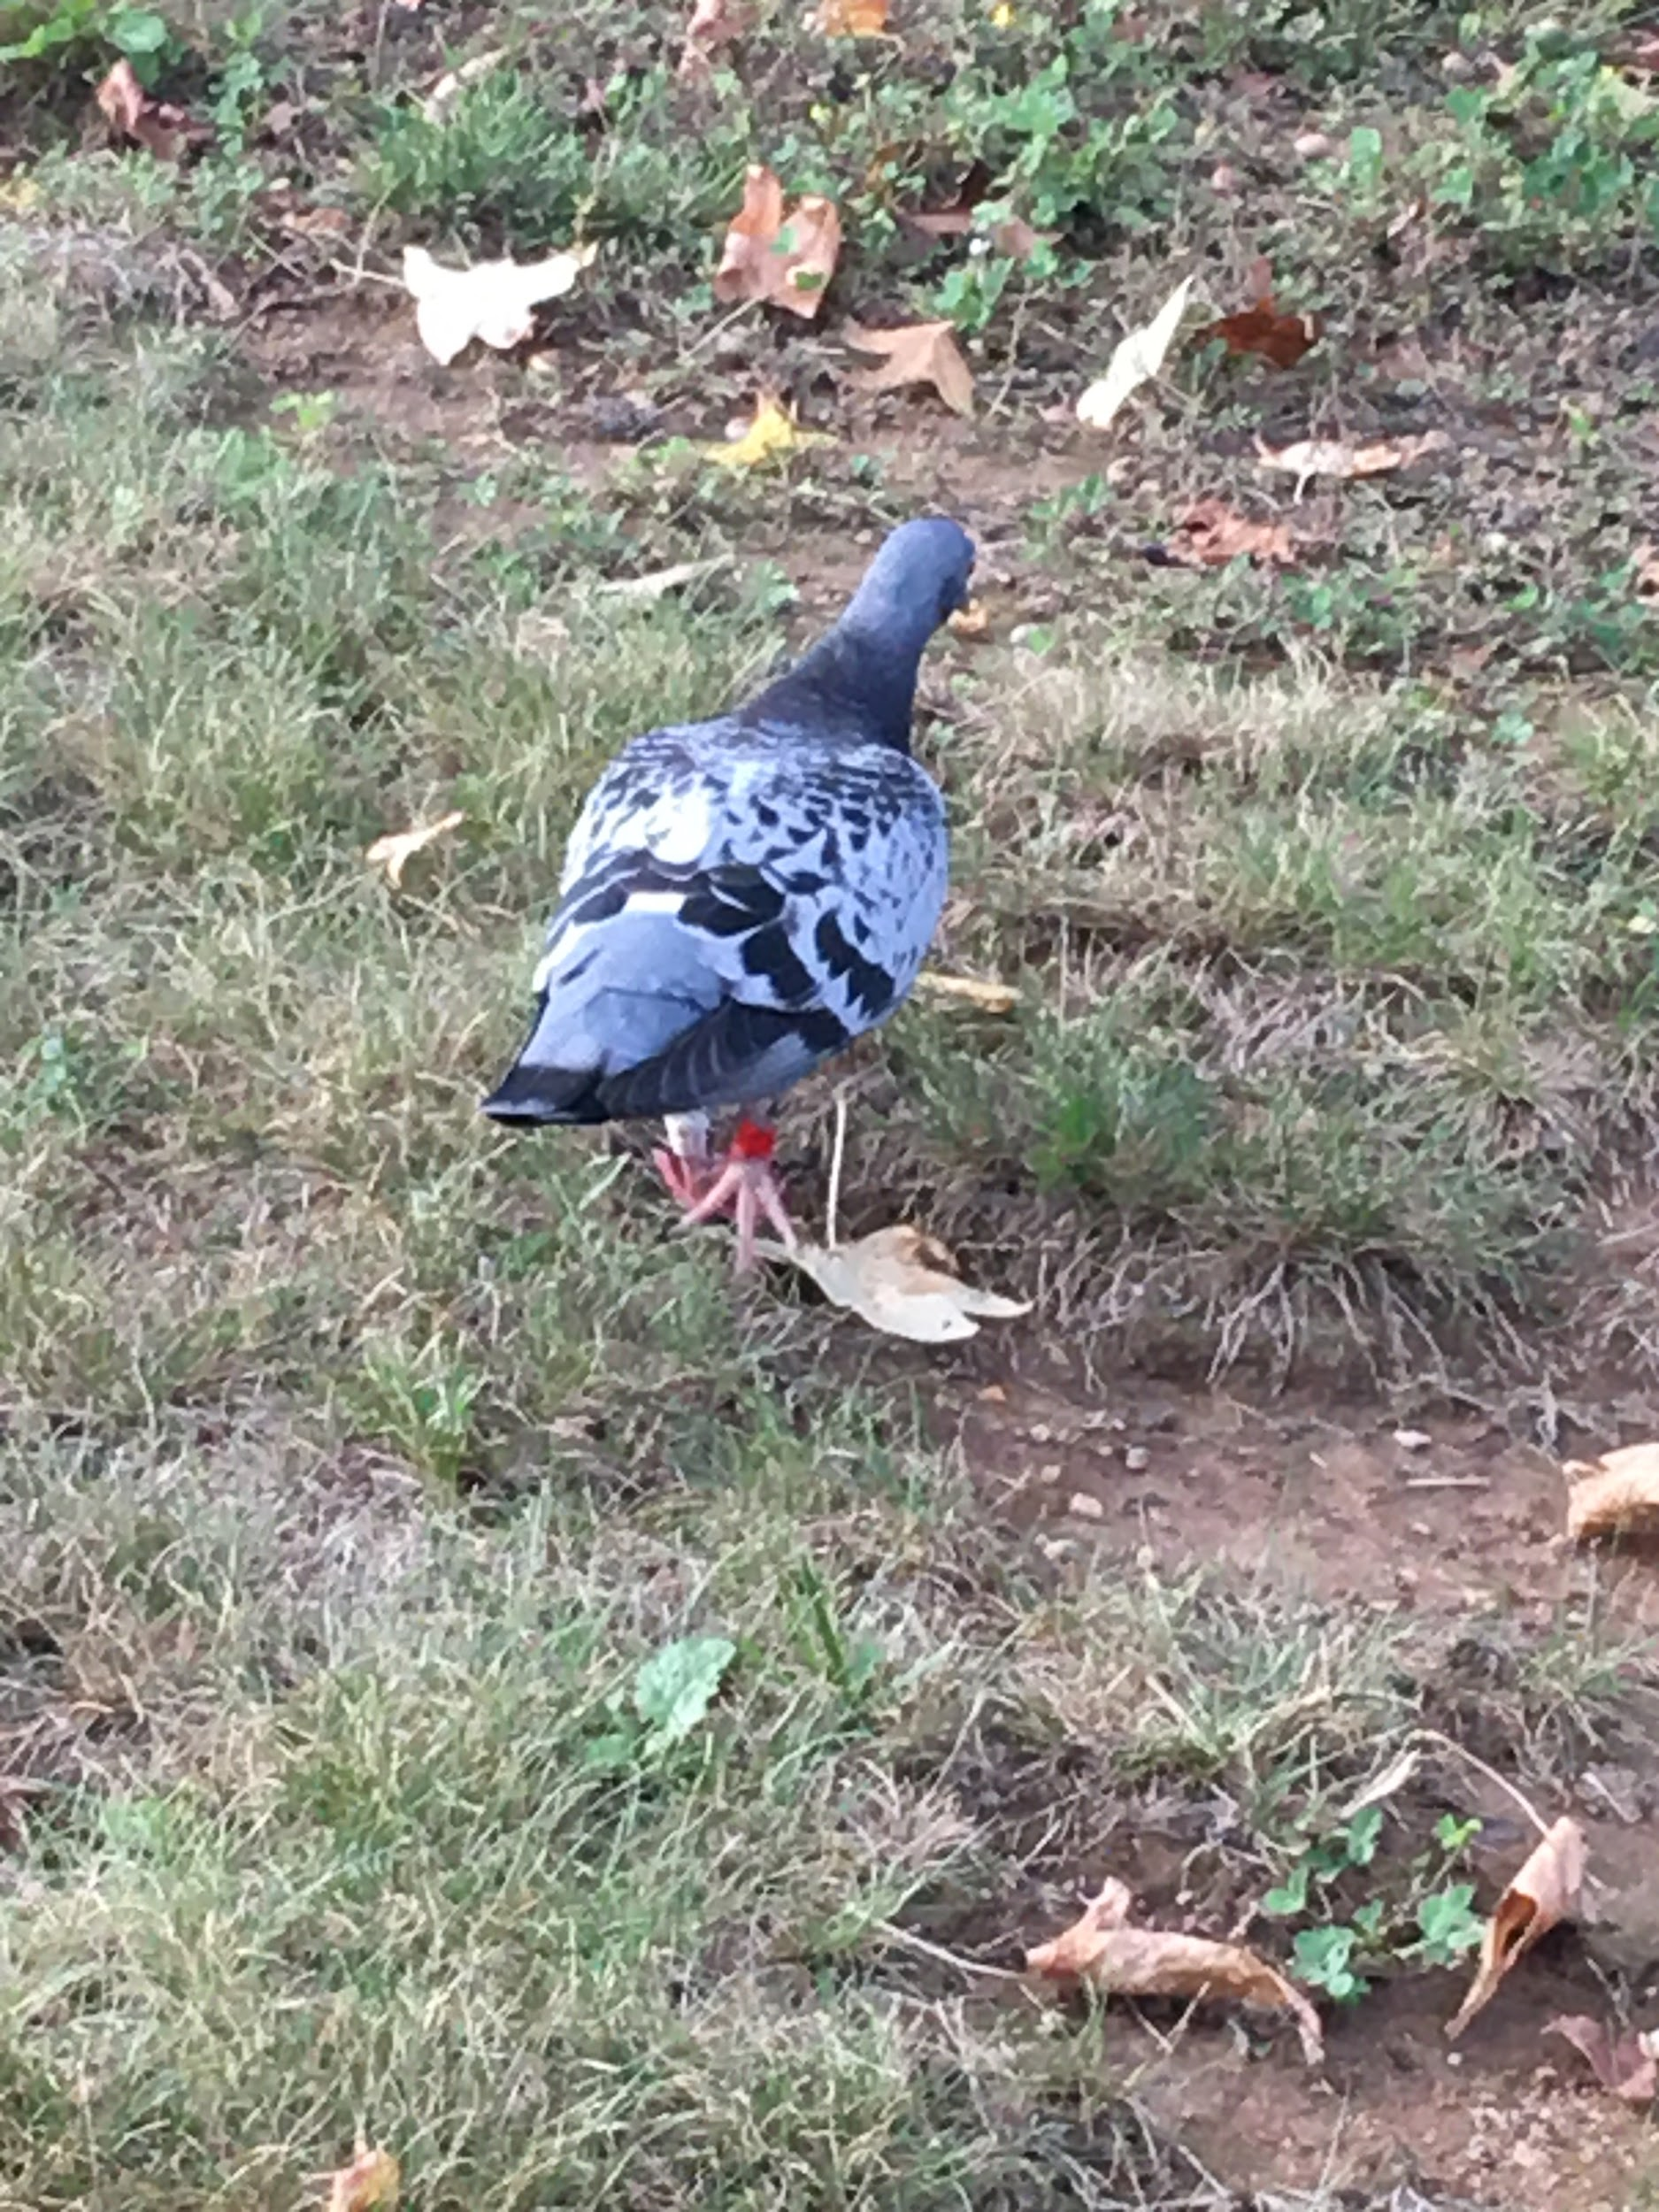
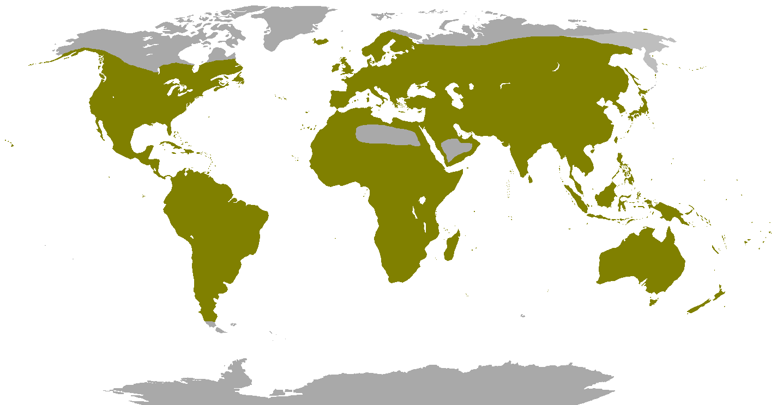
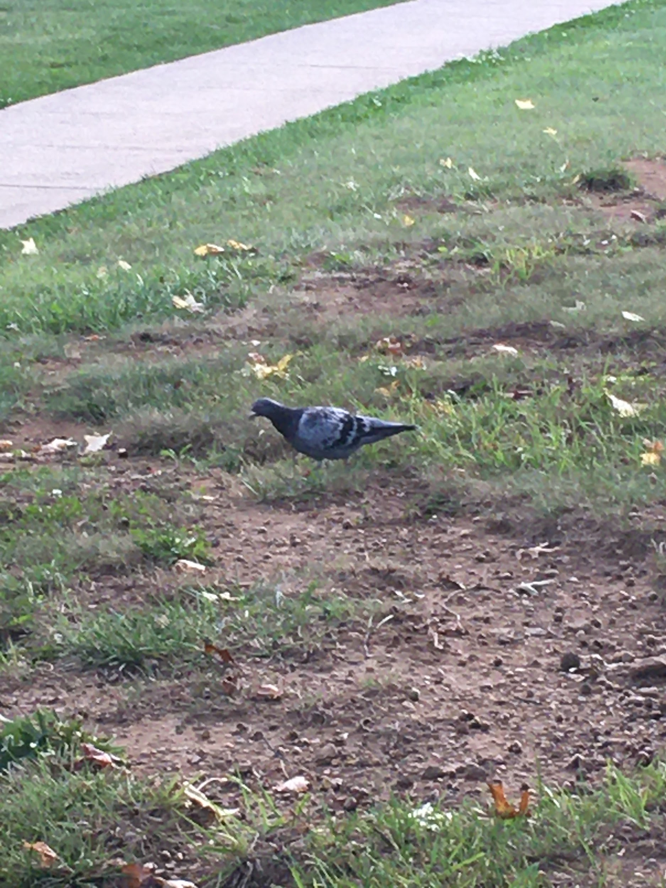
#4
Localized Name: Pigeon
Scientific name: Columba livia domestica
Location: Everywhere that is green (Outside of Dorathy Day)
Date: Oct 1 2020
Habitat: almost anything, flourish in urban areas
Fact: descended from the domestic pigeons

Slide 6
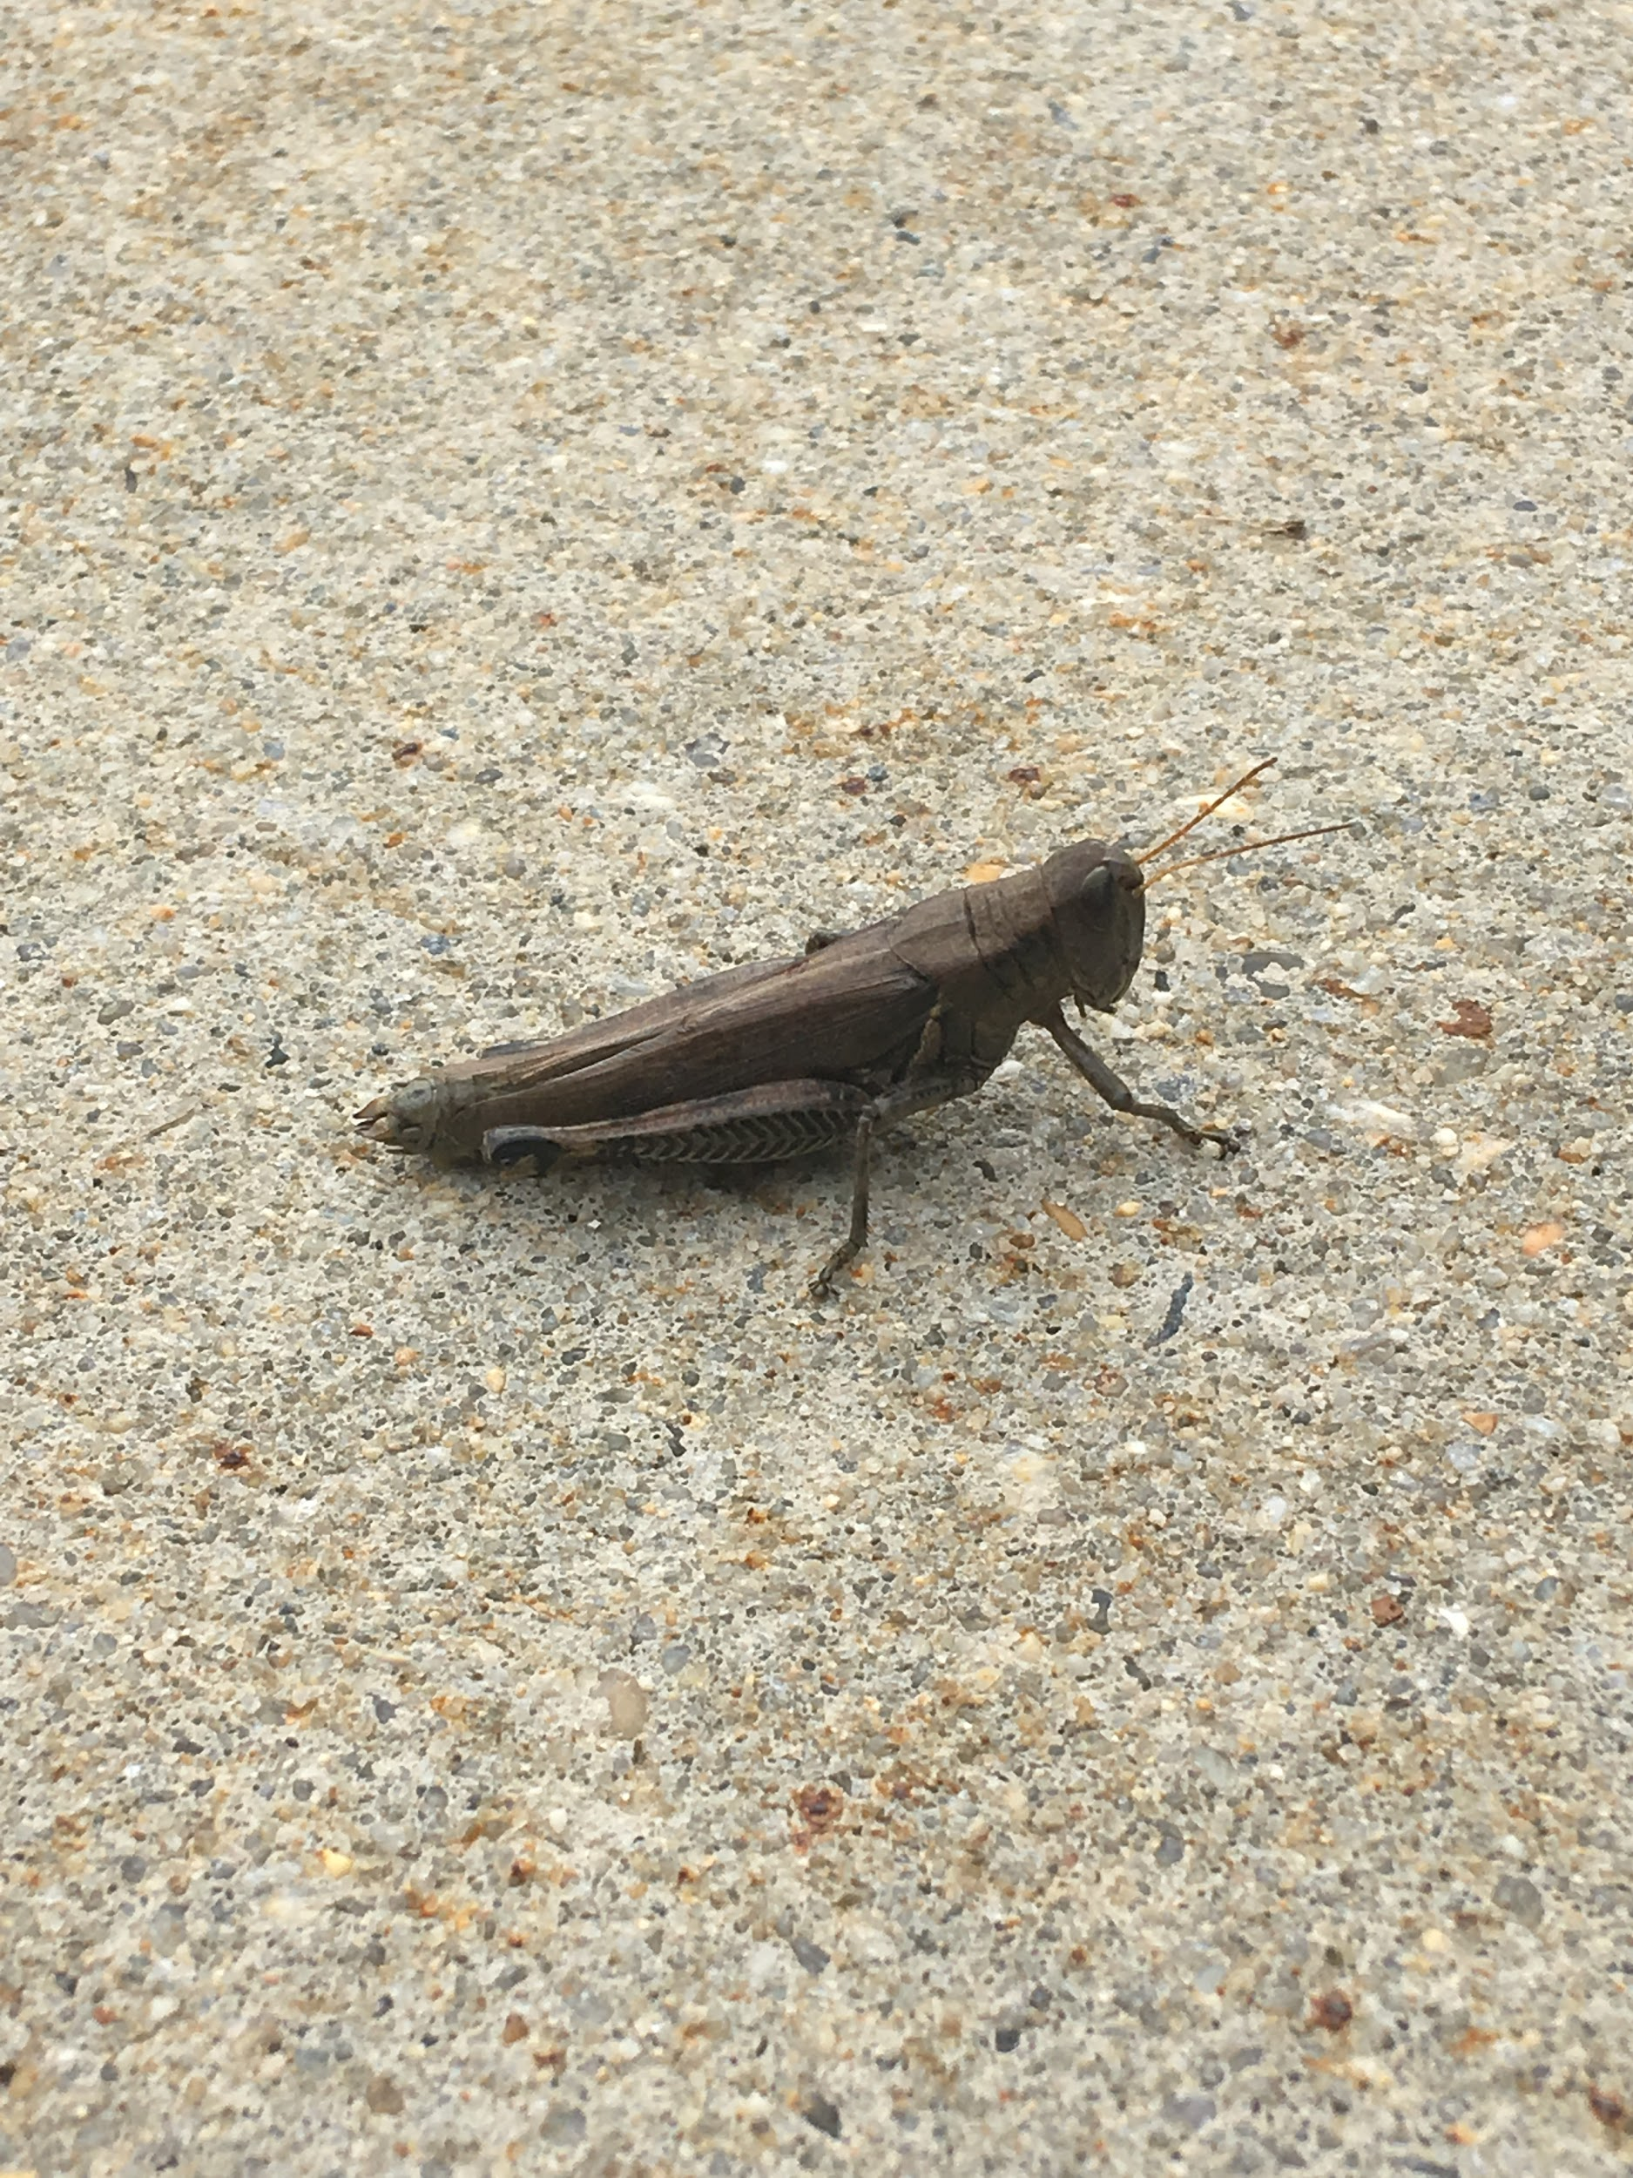
#5
Localized Name: Grasshopper
Scientific name: Schistocerca americana
Location: apparently everywhere, (outside of Dechantal)
Date: October 9 2020
Habitat: dry, grass w/ low plants
Fact: a large amount of cultures have them in mythology

Slide 7
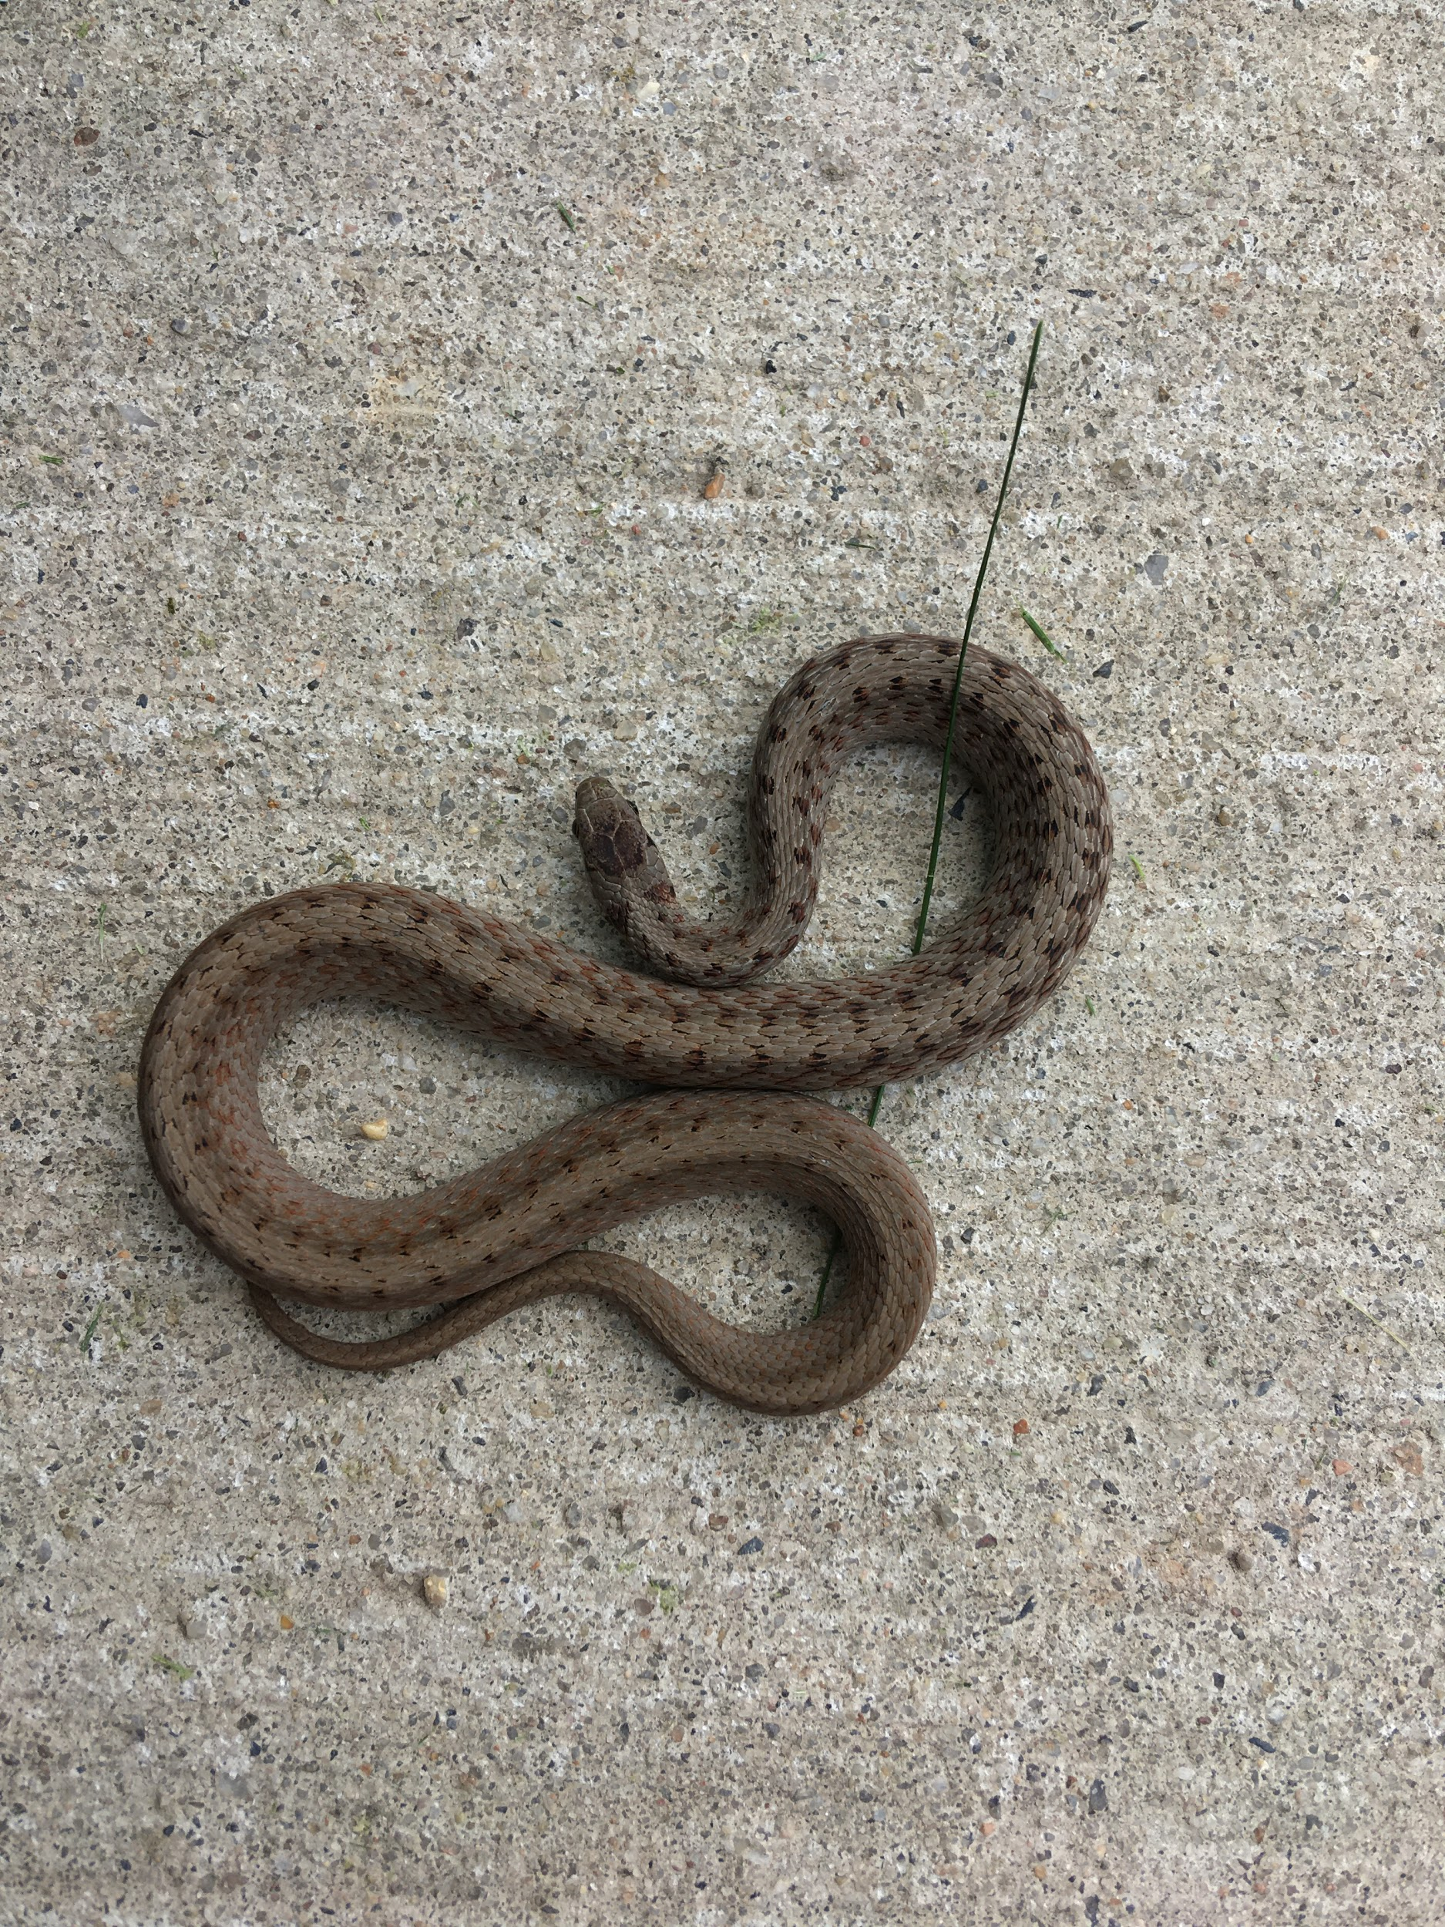
#6
Localized Name: Eastern Gartersnake
Scientific name: Thamnophis sirtalis sirtalis
Location: Eastern United States, (right outside of Dooling (technically found in Dooling))
Date: Aug 10 2020 (this was prior to school was here for IT stuff)
Habitat: Found in nearly all habitats cultivated fields, open canopy forests, swamps, marshes, and bogs to dry upland hillsides and/or human habitats.
Fact: 128-178 ventral scales

Slide 8
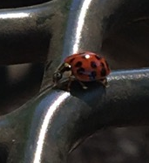
#7
Localized Name: Lady Bug (Beetle)
Scientific name: Coccinella magnifica
Location: Everywhere that isn’t antarctica; (tables by the duc)
Date: September 7 2020
Habitat: close to wood ant nests, usually in woodland but also in heathland
Fact: actually called Lady Beetle

Slide 9
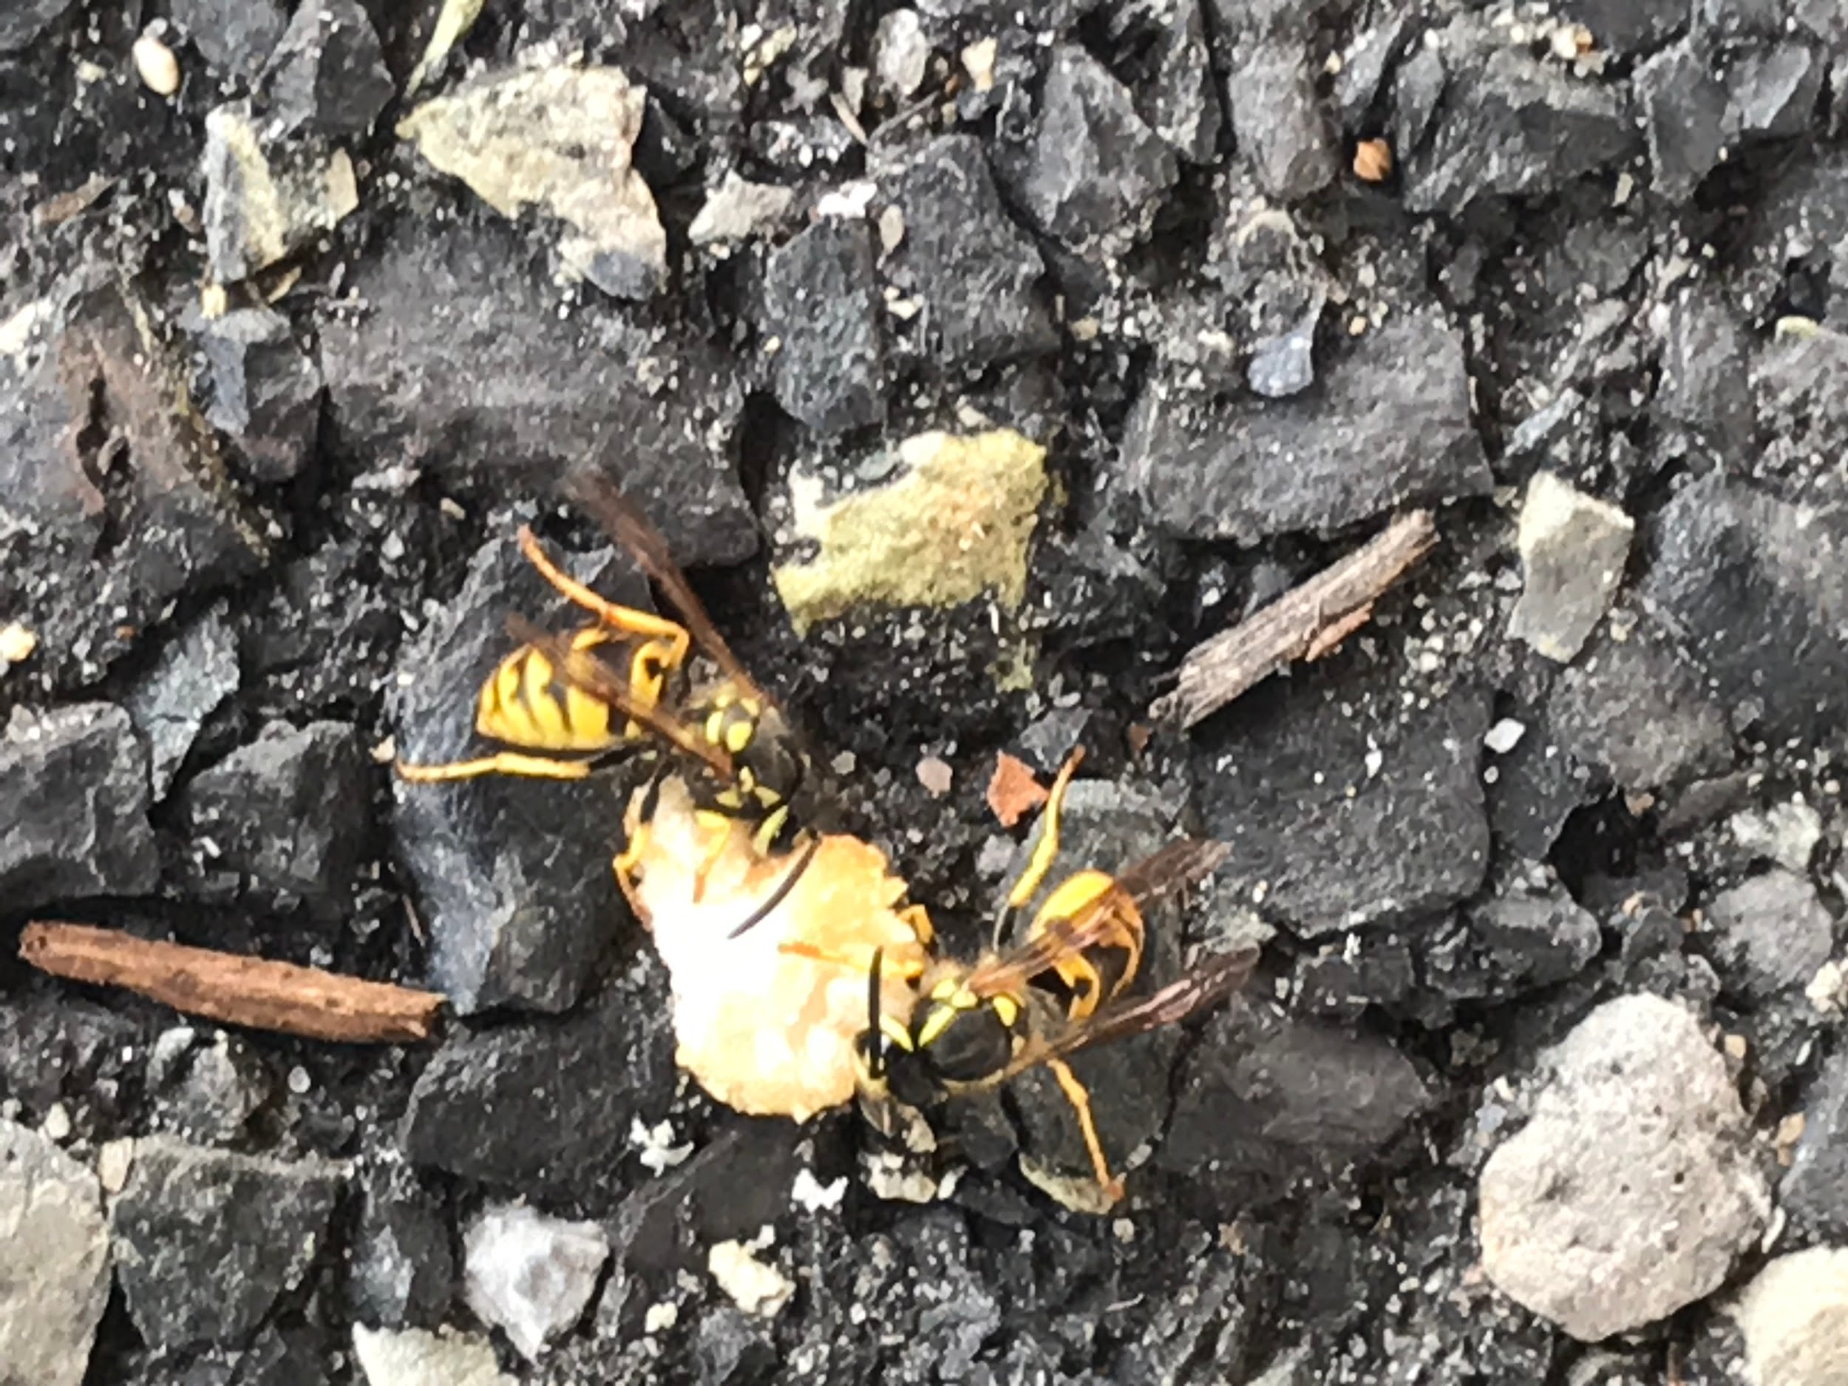
#8
Localized Name: Wasp
Scientific name: Polistes dominula
Location: United States and Canada (DUC parking lot)
Date: September 21 2020
Habitat: generally lives in temperate, terrestrial habitats such as chaparral, forest, and grassland
Fact: They can eat like anything

Slide 10
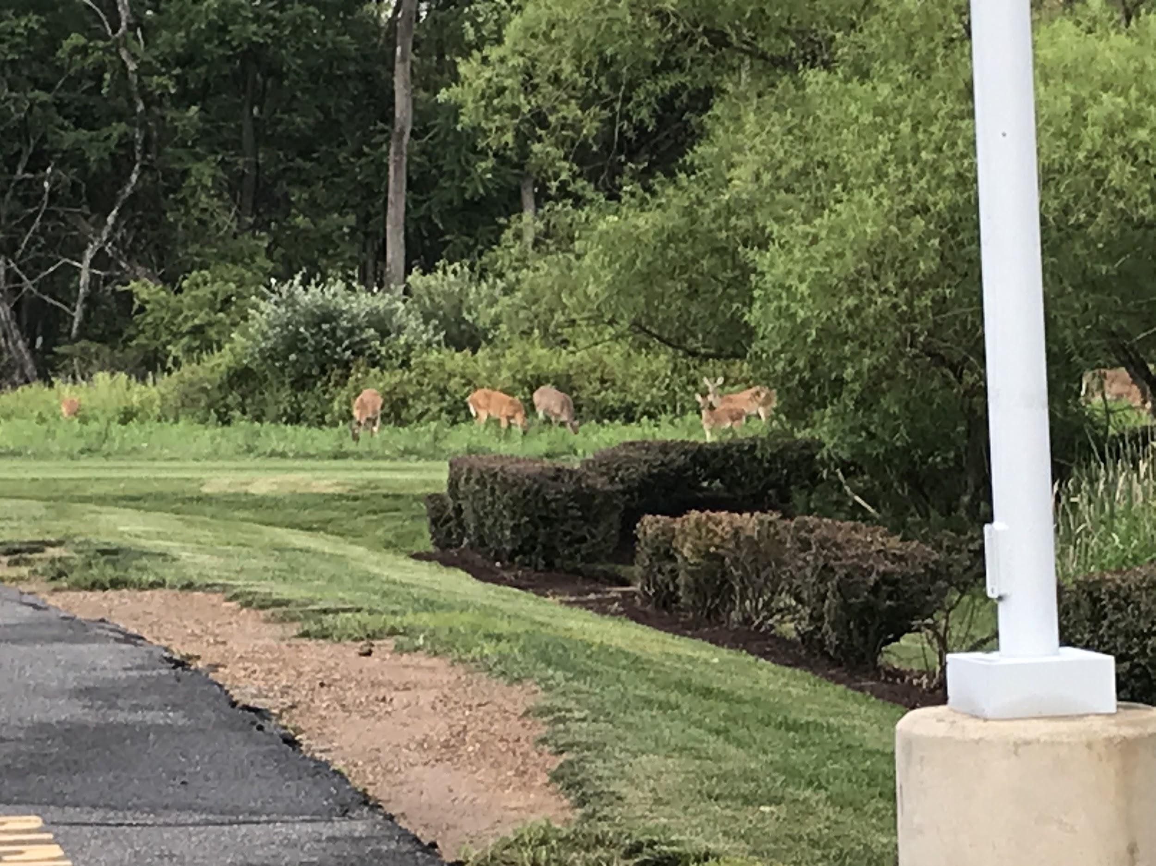
#9
Localized Name: Virginia deer
Scientific name: Odocoileus virginianus
Location: North America, Central America, Ecuador, and South America as far south as Peru and Bolivia (outside of Donahue Hall)
Date: Aug 17 2020
Habitat: forrest, prairie, savanna woodlands, and sage communities
Fact: 2.4 million deer–vehicle collisions in the United States

Slide 11
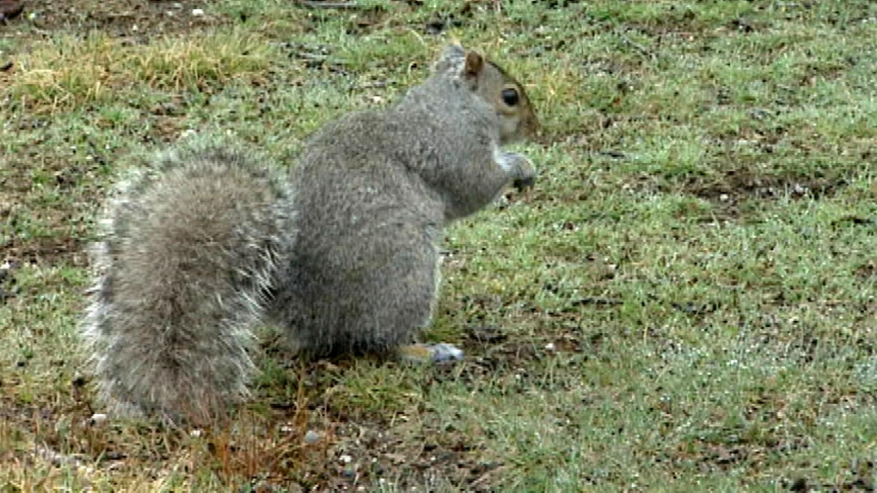
#10
Localized Name: Squirrel (American Red)
Scientific name: Tamiasciurus hudsonicus
Location: While Squirrels are found in most areas of the world the American Red Squirrel keeps to North America with higher concentrations on the coasts (outside of DeChantal)
Date: October 1 2020
Habitat: forrests
Fact: 22% infant (< 1 year) survival rate

